Slide 1
St Thomas’ Primary School
ST THOMAS’ PRIMARY SCHOOL
EDUCATING THE WHOLE CHILD
Excellence Inclusivity Truth Compassion Community
21 November 2019
Year Two
1:1 iPad Parent Presentation
E: admin@stthomas.wa.edu.au T: (08) 9286 9500 W: www.stthomas.wa.edu.au
School Address: 8 Warden Street, Claremont, WA, 6010 ABN 86 980 465 900

Slide 2
ST THOMAS’ PRIMARY SCHOOL
EDUCATING THE WHOLE CHILD
Excellence Inclusivity Truth Compassion Community
St Thomas’ School Prayer
Jesus, bless our school today
Bless everything we do and say,
Bless all those who love us too,
And be our guide in all we do.
Help us to be kind and fair,
And keep us in your love and care.
Amen
E: admin@stthomas.wa.edu.au T: (08) 9286 9500 W: www.stthomas.wa.edu.au
School Address: 8 Warden Street, Claremont, WA, 6010 ABN 86 980 465 900

Slide 3
ST THOMAS’ PRIMARY SCHOOL
EDUCATING THE WHOLE CHILD
Excellence Inclusivity Truth Compassion Community
Why implement a 1:1 iPad Program?
E: admin@stthomas.wa.edu.au T: (08) 9286 9500 W: www.stthomas.wa.edu.au
School Address: 8 Warden Street, Claremont, WA, 6010 ABN 86 980 465 900

Slide 4
ST THOMAS’ PRIMARY SCHOOL
EDUCATING THE WHOLE CHILD
Excellence Inclusivity Truth Compassion Community
E: admin@stthomas.wa.edu.au T: (08) 9286 9500 W: www.stthomas.wa.edu.au
School Address: 8 Warden Street, Claremont, WA, 6010 ABN 86 980 465 900

Slide 5

ST THOMAS’ PRIMARY SCHOOL
EDUCATING THE WHOLE CHILD
Excellence Inclusivity Truth Compassion Community
General capabilities
E: admin@stthomas.wa.edu.au T: (08) 9286 9500 W: www.stthomas.wa.edu.au
School Address: 8 Warden Street, Claremont, WA, 6010 ABN 86 980 465 900

Slide 6
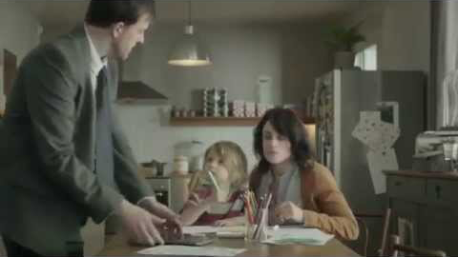
ST THOMAS’ PRIMARY SCHOOL
EDUCATING THE WHOLE CHILD
Excellence Inclusivity Truth Compassion Community
E: admin@stthomas.wa.edu.au T: (08) 9286 9500 W: www.stthomas.wa.edu.au
School Address: 8 Warden Street, Claremont, WA, 6010 ABN 86 980 465 900

Slide 7

ST THOMAS’ PRIMARY SCHOOL
EDUCATING THE WHOLE CHILD
Excellence Inclusivity Truth Compassion Community
Why iPads?
SAMR MODEL
E: admin@stthomas.wa.edu.au T: (08) 9286 9500 W: www.stthomas.wa.edu.au
School Address: 8 Warden Street, Claremont, WA, 6010 ABN 86 980 465 900

Slide 8
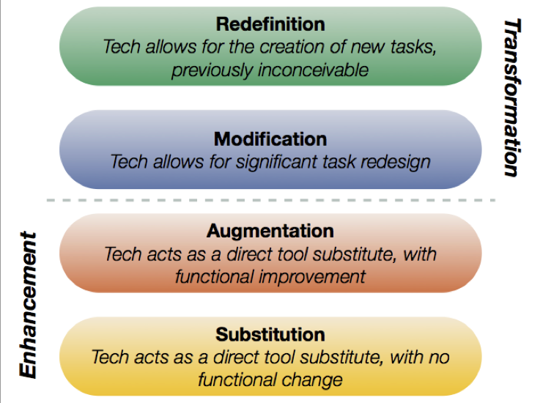
ST THOMAS’ PRIMARY SCHOOL
EDUCATING THE WHOLE CHILD
Excellence Inclusivity Truth Compassion Community
SAMR Model
SAMR MODEL
E: admin@stthomas.wa.edu.au T: (08) 9286 9500 W: www.stthomas.wa.edu.au
School Address: 8 Warden Street, Claremont, WA, 6010 ABN 86 980 465 900

Slide 9
ST THOMAS’ PRIMARY SCHOOL
EDUCATING THE WHOLE CHILD
Excellence Inclusivity Truth Compassion Community
SAMR MODEL
E: admin@stthomas.wa.edu.au T: (08) 9286 9500 W: www.stthomas.wa.edu.au
School Address: 8 Warden Street, Claremont, WA, 6010 ABN 86 980 465 900

Slide 10
ST THOMAS’ PRIMARY SCHOOL
EDUCATING THE WHOLE CHILD
Excellence Inclusivity Truth Compassion Community
iPad 2020 – Specifications
Parents will be required to purchase an iPad for their child going into Year 3 in 2019
If you choose to purchase a Cellular (Wifi + Cellular) iPad, the sim card must be taken out prior to coming to school each day - to allow monitoring of student internet access through the school server
Headphones (with in-built microphone) – Not wireless
No iPad Pro 12.9inch, no iPad Mini, no 32GB model (too small)
Cover/Case - solid protection for the device
Keyboard (optional)
Recommendation is an iPad Air or above with 128GB. Recommendation: 256GB 10.5-inch iPad Pro OR 128GB iPad Air
E: admin@stthomas.wa.edu.au T: (08) 9286 9500 W: www.stthomas.wa.edu.au
School Address: 8 Warden Street, Claremont, WA, 6010 ABN 86 980 465 900

Slide 11
ST THOMAS’ PRIMARY SCHOOL
EDUCATING THE WHOLE CHILD
Excellence Inclusivity Truth Compassion Community
Home Set up
Set up your iPad at home
Download school apps from St Thomas’ Website www.stthomasipadprogram.weebly.com
All you will need is access to Wifi
E: admin@stthomas.wa.edu.au T: (08) 9286 9500 W: www.stthomas.wa.edu.au
School Address: 8 Warden Street, Claremont, WA, 6010 ABN 86 980 465 900

Slide 12
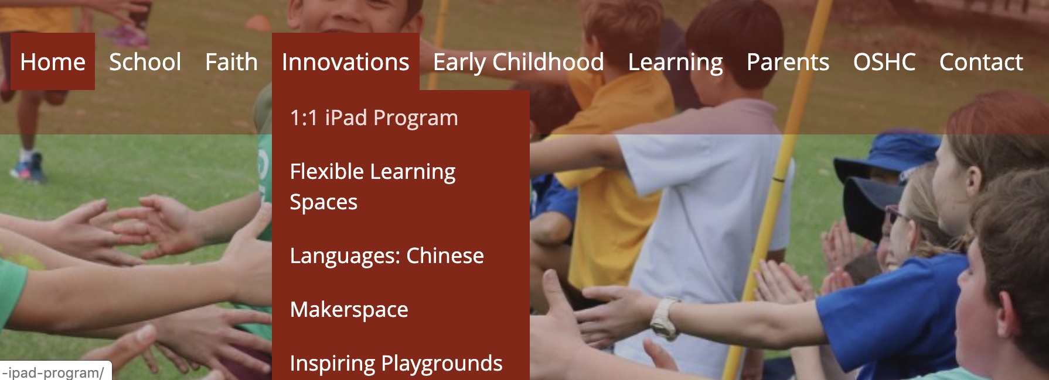
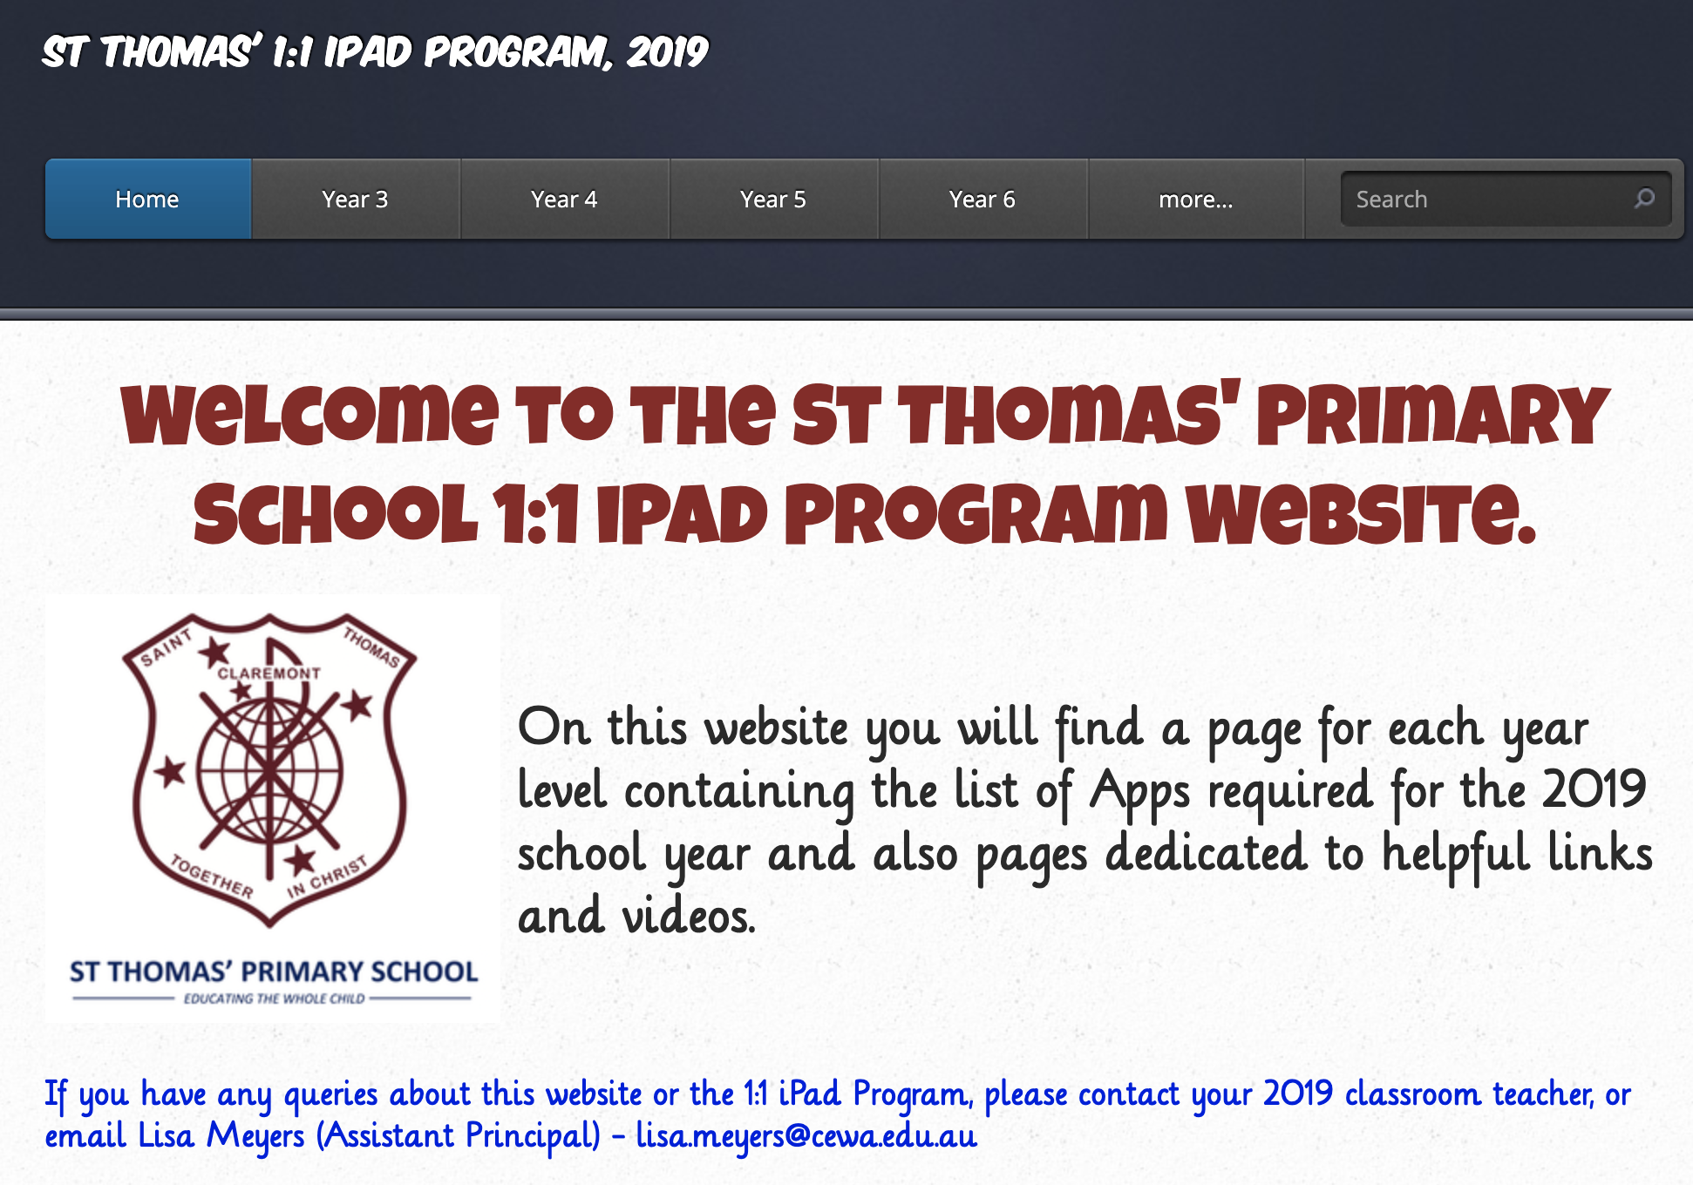
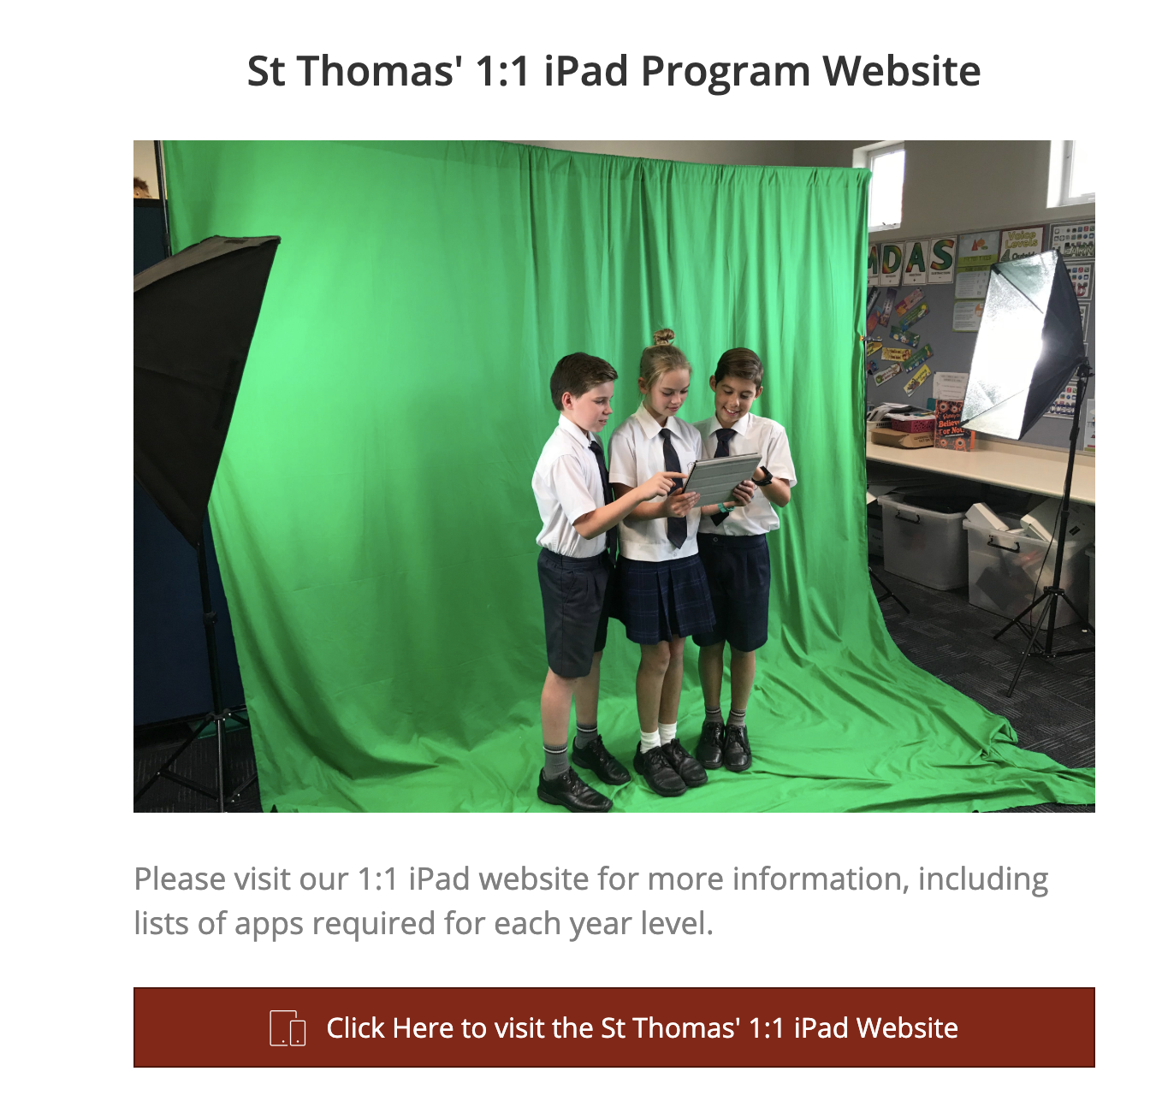
ST THOMAS’ PRIMARY SCHOOL
EDUCATING THE WHOLE CHILD
Excellence Inclusivity Truth Compassion Community
.
E: admin@stthomas.wa.edu.au T: (08) 9286 9500 W: www.stthomas.wa.edu.au
School Address: 8 Warden Street, Claremont, WA, 6010 ABN 86 980 465 900

Slide 13
ST THOMAS’ PRIMARY SCHOOL
EDUCATING THE WHOLE CHILD
Excellence Inclusivity Truth Compassion Community
Apple ID Password
E: admin@stthomas.wa.edu.au T: (08) 9286 9500 W: www.stthomas.wa.edu.au
School Address: 8 Warden Street, Claremont, WA, 6010 ABN 86 980 465 900

Slide 14
ST THOMAS’ PRIMARY SCHOOL
EDUCATING THE WHOLE CHILD
Excellence Inclusivity Truth Compassion Community
School Set up
During the first week of school next year, we will set up each child’s iPad to enable:
Students to connect automatically to the school wireless network
Communicate with the Apple TV’s in the classroom.
E: admin@stthomas.wa.edu.au T: (08) 9286 9500 W: www.stthomas.wa.edu.au
School Address: 8 Warden Street, Claremont, WA, 6010 ABN 86 980 465 900

Slide 15
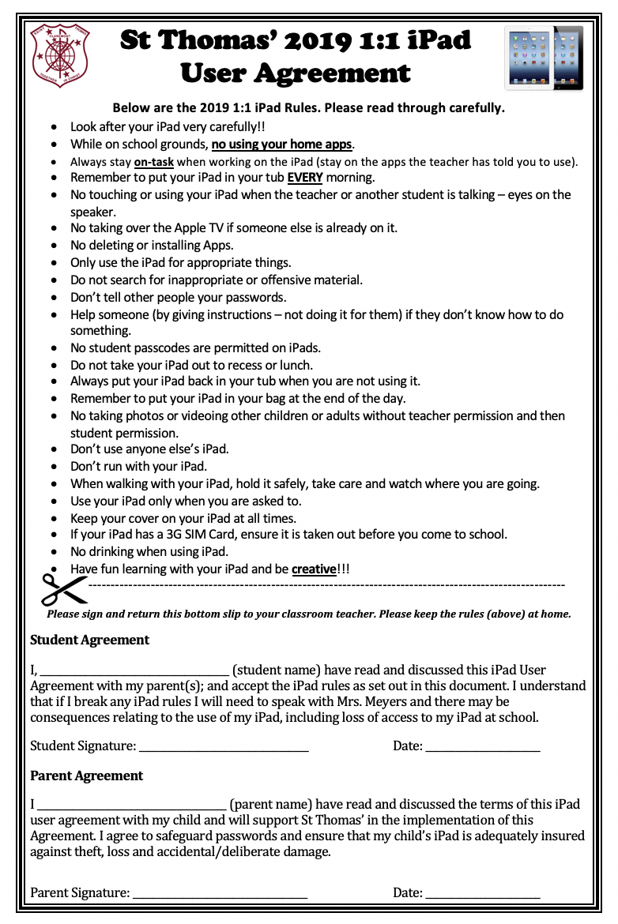

ST THOMAS’ PRIMARY SCHOOL
EDUCATING THE WHOLE CHILD
Excellence Inclusivity Truth Compassion Community
iPad Student User Agreement
Students will be asked to sign a ‘Student User Agreement.’
E: admin@stthomas.wa.edu.au T: (08) 9286 9500 W: www.stthomas.wa.edu.au
School Address: 8 Warden Street, Claremont, WA, 6010 ABN 86 980 465 900

Slide 16
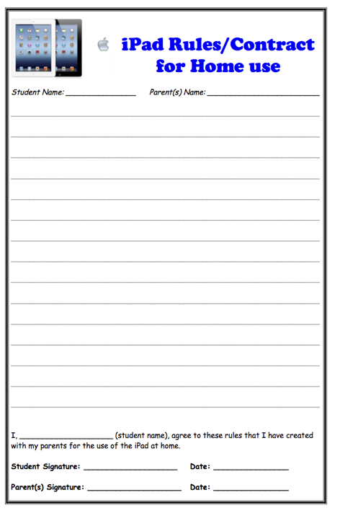
ST THOMAS’ PRIMARY SCHOOL
EDUCATING THE WHOLE CHILD
Excellence Inclusivity Truth Compassion Community
iPad Home Contract
E: admin@stthomas.wa.edu.au T: (08) 9286 9500 W: www.stthomas.wa.edu.au
School Address: 8 Warden Street, Claremont, WA, 6010 ABN 86 980 465 900

Slide 17
ST THOMAS’ PRIMARY SCHOOL
EDUCATING THE WHOLE CHILD
Excellence Inclusivity Truth Compassion Community
Parent and Teacher Checklist
No password to activate the iPad.
All home apps are on a separate page to the school requested apps.
Set Airdrop to ‘Allow me to be discovered by: No One. The school will turn this on if required to Airdrop.
Complete a photo/video library check on a Monday.
Complete an internet ‘History’ check on a Monday and ask students to clear history on a Monday morning and Friday afternoon.
Check that iMessage in settings is switched off every morning and left off till 3pm.
Check that Face Time in settings is switched off every morning and left off till 3pm.
In Safari settings, check that Pop-ups, Cross-Site Tracking, Camera and microphone and Preload Top Hit is blocked, Website data is cleared.
If the iPad is a hand-me-down, make sure it must be reset correctly and all the email accounts are deleted.
E: admin@stthomas.wa.edu.au T: (08) 9286 9500 W: www.stthomas.wa.edu.au
School Address: 8 Warden Street, Claremont, WA, 6010 ABN 86 980 465 900

Slide 18
ST THOMAS’ PRIMARY SCHOOL
EDUCATING THE WHOLE CHILD
Excellence Inclusivity Truth Compassion Community
Tips for Parents at Home
No password to activate the iPad
Set Airdrop to ‘Allow me to be discovered by: No One.
Go to Game Center and turn off: nearby players, check profile name is not their real name and alert parent if the Game Center is turned on. Check and note the names of the friends on Game Center. (If student is signed up for Game Center, they must turn off “Allow Game Invites” and “Find Me By Email” while at school. This will keep students safe from unwanted contact with strangers).
Be mindful of age appropriateness of apps
If the iPad is a hand-me-down, make sure it must be reset correctly and all the email accounts are deleted.
E: admin@stthomas.wa.edu.au T: (08) 9286 9500 W: www.stthomas.wa.edu.au
School Address: 8 Warden Street, Claremont, WA, 6010 ABN 86 980 465 900

Slide 19
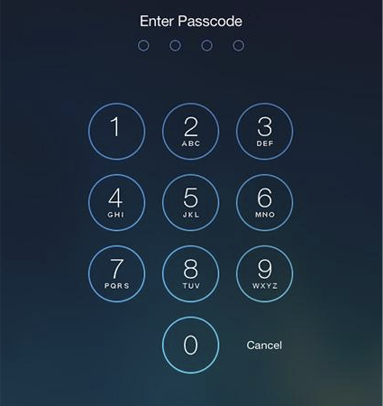
ST THOMAS’ PRIMARY SCHOOL
EDUCATING THE WHOLE CHILD
Excellence Inclusivity Truth Compassion Community
No iPad Passcode
E: admin@stthomas.wa.edu.au T: (08) 9286 9500 W: www.stthomas.wa.edu.au
School Address: 8 Warden Street, Claremont, WA, 6010 ABN 86 980 465 900

Slide 20
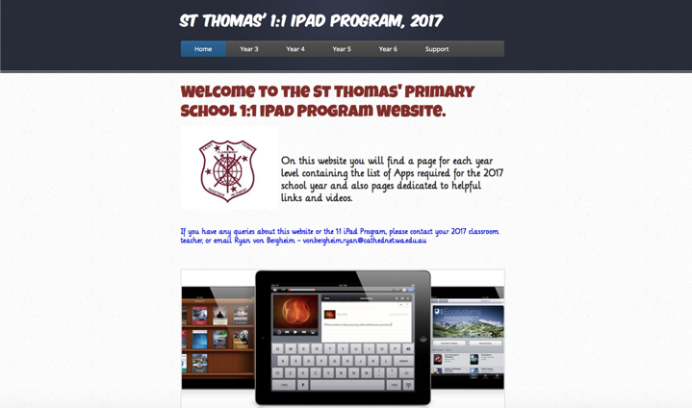
ST THOMAS’ PRIMARY SCHOOL
EDUCATING THE WHOLE CHILD
Excellence Inclusivity Truth Compassion Community
St Thomas’ iPad Website
This presentation and the Home Contract is available on the website.
E: admin@stthomas.wa.edu.au T: (08) 9286 9500 W: www.stthomas.wa.edu.au
School Address: 8 Warden Street, Claremont, WA, 6010 ABN 86 980 465 900

Slide 21
ST THOMAS’ PRIMARY SCHOOL
EDUCATING THE WHOLE CHILD
Excellence Inclusivity Truth Compassion Community
Additional Information
Paul Litherland
https://www.surfonlinesafe.com.au/
Western Australian Government
https://www.education.wa.edu.au/cyber-safety
E: admin@stthomas.wa.edu.au T: (08) 9286 9500 W: www.stthomas.wa.edu.au
School Address: 8 Warden Street, Claremont, WA, 6010 ABN 86 980 465 900

Slide 22

ST THOMAS’ PRIMARY SCHOOL
EDUCATING THE WHOLE CHILD
Excellence Inclusivity Truth Compassion Community
Questions???
E: admin@stthomas.wa.edu.au T: (08) 9286 9500 W: www.stthomas.wa.edu.au
School Address: 8 Warden Street, Claremont, WA, 6010 ABN 86 980 465 900

